Slide 1
BASICS OF ENTREPRENEURSHIP

Slide 2
5ZC22 – BASICS OF ENTREPRENEURSHIP
Unit – I: Introduction to Entrepreneurship: - Define Entrepreneurship, Entrepreneurship as a Career option, Benefits and Myths of Entrepreneurship, Success Rate of Entrepreneurs related to Experience and Family Backup, Characteristics, Qualities and Skills of Entrepreneurship, Entrepreneurial Propensity, Life as an Entrepreneur, Impact of Entrepreneurship on Economy and Society.
Unit – II: Opportunity & Customer Analysis: - Identify your Entrepreneurial Style, Identify Business Opportunities, Methods of finding and understanding Customer Problems, Process of Design Thinking, Identify Potential Problems, Customer Segmentation and Targeting, Customer Adoption Process, craft your Values Proportions, Customer-driven Innovation.

Slide 3
Unit – III: Business Model & Validation: - Types of Business Models, Lean approach, the Problem-Solution Test, Solution Interview Method, difference between Start-up Venture and Small Business, Industry Analysis, Identify Minimum Viable Product (MVP), Build-Measure-Lean Feedback loop, Product-market fit test.
Unit – IV: Economics & Financial Analysis: - Revenue sources of Companies, Income Analysis, and Costs Analysis - Product Cost and Operations Cost, basics of Unit Costing, Break Even Analysis Profit Analysis, Customer Value Analysis, different Pricing Strategies, advantages and disadvantage of various Sources of Finance, Investors Expectations, Return on Investment , Practice pitching to Investors and Corporate.

Slide 4
Unit – V: Team Building & Project Management: - Leadership Styles, Shared Leadership Model, Team Building in Venture, Role of good team in venture, Roles and Respondents, Explore collaboration tools and techniques- Brainstorming, Mind mapping. Importance of Project Management, Time Management, Workflow, Network Analysis Techniques – Critical Path Method, Project Evaluation Review Technique and Gantt chart.
Unit – VI: Marketing & Business Regulations: - Positioning, Positioning Strategies, building Digital presence and leveraging Social Media, Measuring effectiveness of Channels, Customer Decision-making Process, Sales Plans and Targets, Unique Sales Proposition (USP), Follow-up and close Sales. Business regulations of starting and operating a Business, Start-up Ecosystem, Government schemes.

Slide 5
Books Recommended
Robert D Hisrich, Michael P Peters, Dean A Shepherd, Entrepreneurship, Sixth Edition, New Delhi, 2006.
Thomas W. Zimmerer, Norman M. Scarborough, Essentials of Entrepreneurship And Small Business Management, Fourth Edition, Pearson, New Delhi, 2006
Alfred E. Osborne, Entrepreneur’s Toolkit, Harvard Business Essentials, HBS Press, USA, 2005.
Madhurima Lall, Shikha Sahai, Entrepreneurship, Excel Books, First Edition, New Delhi, 2006.
S.S. Khanka, Entrepreneurial Development, S. Chand and Company Limited, New Delhi, 2007.
H. Nandan, Fundamentals of Entrepreneurship, Prentice Hall of India, First Edition, New Delhi, 2007.
S.R. Bhowmik, M. Bhowmik, Entrepreneurship-A tool for Economic Growth And A key to Business Success, New Age International Publishers, First Edition, (formerly Wiley Eastern Limited), New Delhi, 2007

Slide 6
Unit – I: Introduction to Entrepreneurship
Meaning of Entrepreneur
The word “Entrepreneur” has been taken from the French Language Enterprendre which means “ to undertake “ and meant to organize musical or other entertainment programs.
Oxford Dictionary (1897) also defined entrepreneur as the director or manager of a public musical institution.
Entrepreneurship is the Process of creating something new and assuming the risks and rewards. Robert D.Hisrich, M.P.Peters & D.A.Shepherd
Entrepreneur
Entrepreneurship
Innovation
Person
Process
Object

Slide 7
It was Schumpeter however, who really launched the field of entrepreneurship by associating it clearly with innovation. Peter Drucker defined Entrepreneurship as ‘a systematic innovation, which consists in the purposeful and organized search for changes, and it is the systematic analysis of the opportunities such changes might offer for economic and social innovation.
Entrepreneur is a person who starts an enterprise. The process of creation is called entrepreneurship.
The entrepreneur is the actor and entrepreneurship is the act. The outcome of the actor and the act is called the enterprise.
An enterprise is the business organization that is formed and which provides goods and services, creates jobs, contributes to national income, exports and over all economic development.

Slide 8
Entrepreneurship Entrepreneurship is defined as the professional application of knowledge, skills and competencies of generating a new business idea, by an individual or a set of people by launching an enterprise or business organization to pursue growth while generating wealth, employment and social good.
Entrepreneur
Entrepreneur is defined as an agent who buys factors of production at certain prices in order to combine them into product with a view to selling it at uncertain prices in future.
Entrepreneur is defined as one who combines the land of one, the labor of another and the capital of yet another and thus produces the product.

Slide 9
Difference b/w Entrepreneurship and Entrepreneur
Entrepreneurship can be described as a process of setting up an enterprise.
Entrepreneurship is a creative activity.
Entrepreneurship is the attitude of mind to seek opportunities, take calculated risks and derive benefits by setting up a venture.
Entrepreneur is a person who starts an enterprise.
The process of creation is called entrepreneurship.
The entrepreneur is the actor and entrepreneurship is the act.
The outcome of the actor and the act is called the enterprise.

Slide 10
Entrepreneurship as a Career option
Freedom to work and be your own boss and also boss to others.
Freedom to make money for oneself rather than for someone else.
Participation in every aspect of running of a business, learning new things and gaining experience.
Work directly for the customers and gain first-hand experience about their needs.
Personal satisfaction of owning and running a business venture.
Build a retirement value and gain respect for family and friends.
Satisfaction of being the creator of jobs for many people.

Slide 11
Benefits and Myths of Entrepreneurship
Benefits of Entrepreneurship
Opportunity to create your own destiny: Owning a business provides an entrepreneurs the independence and the opportunity to achieve what is important to them.
Opportunity to make a Difference : More and more entrepreneurs are starting businesses because they see this as an opportunity to make a difference in a route or way that is personally important to them.
Opportunity to reap extraordinary profits: The profit earned by an entrepreneur are an important motivation and indication factor for further increased performance. Thus these could spur them to greater achievement and success.

Slide 12
Societal Responsibility and Recognition: Small business owners are among the most admired, respected and trusted individuals of society.
Opportunity to engage in work of their choice : Small business owners tend to engage in business that gives them personal satisfaction.
Entrepreneurs see their business as a vehicle of self expression of personal desire and eventual self actualization of their personal goals – the pinnacle of their career success.

Slide 13
Myths of Entrepreneurship
Myth 1: Entrepreneurs Are Doers, Not Thinkers
Myth 2: Entrepreneurs Are Born, Not Made
Myth 3: Entrepreneurs Are Always Inventors
Myth 4: Entrepreneurs Are Academic and Social Misfits
Myth 5: Entrepreneurs Must Fit the “Profile”
Myth 6: All Entrepreneurs Need Is Money
Myth 7: All Entrepreneurs Need Is Luck
Myth 8: Ignorance Is Bliss For Entrepreneurs
Myth 9: Entrepreneurs Seek Success But Experience High Failure Rates
Myth 10: Entrepreneurs Are Extreme Risk Takers (Gamblers)

Slide 14
Types Of Entrepreneurs
Pure Entrepreneur : He is motivated by psychological and economic rewards. He starts activities for his personal satisfaction is work, ago or status.
Induced Entrepreneur : Such entrepreneur is induced to take up an entrepreneurial task due to the policy measures of the government.
Motivated Entrepreneur : Such an entrepreneur is motivated by the desire for self-fulfilment. He is also motivated by the desire for innovations and profit.
Growth Entrepreneur : These entrepreneurs choose an industry which has high growth prospects.
Women Entrepreneurs: An enterprise owned and controlled by a women having a minimum financial interest of 51% of the capital and giving at least 51% of employment generated in the enterprise to women.

Slide 15
Super-Growth Entrepreneur : He is an individual who has shown enormous growth performance in has venture.
First-Growth Entrepreneur : He is one who starts an industrial unit by means of an innovative skill.
Modern Entrepreneur : He is one who undertakes those ventures which go well along with the changing demand in the market. He cares for the current marketing needs.
Copreneurs : It is related to the married couples working together in a business. When a married couple shares ownership, commitment and responsibility for a business, they are called ‘copreneurs’.
Young Entrepreneurs and Part-Time Entrepreneurs : Starting a part-time business is a popular gateway to entrepreneurship. Part-time entrepreneurs can easily enter into business without sacrificing their service benefits.

Slide 16
Entrepreneurship on the Basis of Stages of Economic Development
Clarence Danhof classifies entrepreneur into four types
Innovative: An Innovating entrepreneur is one who introduces new products, new methods of production and new technology. Example: Hennery Ford wanted to replace the petrol fuel or the diesel engine with the Kerosene fuel system.
Imitative or Adoptive: Imitative entrepreneur is characterized by readiness to adopt successful innovation initiated by innovating entrepreneurs. China is a growing economy that provides large opportunity to its citizens. Among them the cellular market is growing through adaptation and modification of the innovative product by the Innovative Companies.

Slide 17
3. Fabian: Fabian entrepreneurs are lazy and shy. They lack the will to adopt new methods of production. Fabian are more applicable in the Indian rural agriculture environment.
4. Drone: Drone entrepreneur is one who follows the traditional methods of production. There is a “Beeree” (Old fashion tobacco making process) producer Co-operative that uses employee to make the tobacco by hand. Even though it is a dying industry but it does not stop them.

Slide 18
Success Rate of Entrepreneurs related to Experience and Family Backup
AJAY PIRAMAL - PIRAMAL ENTERPRISES LIMITED
AMAR BOSE - BOSE CORPORATION
S. ANANTHARAMAKRISHNAN – AMALGAMATION GROUP
ANIL AGARWAL – VEDANTA GROUP
AZIM PREMJI – WIPRO
BHAI MOHAN SINGH - RANBAXY LABORATORIES LTD
BRIJMOHAN LAL MUNJAL - THE HERO GROUP
CHETAN MAINI - REVA ELECTRIC CAR
DEEPAK PAREKH – HDFC
DHIRUBHAI AMBANI – RELIANCE GROUP
EKTA KAPOOR - BALAJI TELEFILMS
GALLA RAMACHANDRA NAIDU – AMARARAJA BATTERIES
GAUTAM ADANI - ADANI GROUP
RAMOJI RAO – RAMOJI CITY

Slide 19
GHANSHYAM DAS BIRLA – BIRLA GROUP
GOENKA. R.P. – RPG GROUP
JEYSINGH THOMAS - AVT GROUP
JINDAL, O.P. - JINDAL GROUP
JOHN YESUDHAS, V.F. – WAVETEL
KALLAM ANJI REDDY - DR REDDY'S LABS
KARSANBHAI PATEL – NIRMA
KIRAN MAZUMDAR-SHAW - BIOCON LTD
KISHORE BIYANI – PANTALOON
KOCHOUSEPH CHITTILAPPILLY -V GUARD
MOHAN SINGH OBEROI - OBEROI GROUP
NARAYANA MURTHY, N. R. – INFOSYS
NARESH GOYAL - JET AIRWAYS
DR. PRATAP C REDDY - APOLLO HOSPITAL GROUP
RAMNATH GOENKA - INDIAN EXPRESS GROUP

Slide 20
Characteristics of Entrepreneurs
According to John Hornaday, the characteristics of entrepreneurs are:
Self Confidence, Energy, Diligence
Ability to take calculated risk
Creativity , Flexibility
Positive response to challenges
Dynamism, leadership
Ability to get along with people
Responsiveness to suggestions
Responsiveness to Criticism
Knowledge of market ,product and technology
Perseverance, determination
Resourcefulness, Need to achieve
Initiative, Independence
Foresight, Profit orientation
Perceptiveness, Optimism, Versatility

Slide 21
Functions of Entrepreneurs
The main functions of entrepreneurs are
Planning
Risk and Uncertainty bearing
Organization building
Managing
Decision making
Innovation
Leading
Managing growth

Slide 22

Qualities and Skills of Entrepreneurship
Qualities of Entrepreneurship
Ability to Innovate
Business oriented tendency
Organizing function
Managerial and leadership function
Knowledge based function
Based on principles, not on intuition essential in every activity.

Slide 23
Skills of Entrepreneurship
Communication skills (possessing the ability to read, write and speaking in an understandable, accurate and professional manner)
Human relations skills (the ability to build and maintain positive relationships, working well with others)
Math skills (knowledge of basic arithmetic and business math skills such as calculating profit)
Problem-solving and Decision-making skills (the ability to assess situation and make good decisions)
Technical skills (knowledge of computers and how to use them productively)
Business skills (knowledge and understanding of the economy and business functions such as marketing and management)

Slide 24
Entrepreneurial Process
Six Stage Entrepreneurial Process
Identifying an Opportunity
Identifies opportunities where others do not
Establishing a Vision
Has a clear understanding of the concept
Persuade other’s
Communicates the Concept clearly
Gather Resources
Money, People and Things
Create new Venture / Product / Market
Organizes resources to create new venture
Change / Adapt with Time
Meets the changing demands of the market

Slide 25
Entrepreneurial Propensity
Entrepreneurial Propensity is defined as Individual’s favorable predisposition (Inclination or tendency) towards new venture creation.
Individual Decision to start a business is influenced by the personality of the individual who want to become an entrepreneur and start up environment

Slide 26
Entrepreneurial Propensity Model
Entrepreneurial Propensity
Personal Values / Personality Traits
Locus of Control
Gender
Leadership
Risk Taking
Self- Confidence
Internal
External

Slide 27
Locus of Control
Internal locus of control is defined as the personal belief that one has influence over outcomes through ability, effort, or skills, whereas external locus of control is the belief that external forces control outcomes
External locus of control can be explained by people’s beliefs about powerful others that influence their lives, as well as the influence of blind fate, luck or chance.

Slide 28
Life as an Entrepreneur
For an individual, the role and type of career he or she chooses is of great importance because, it lays down his or her pattern of living, determines social status and controls one’s present and future life. Any individual has three options.
To work for someone else
To be self – employed in a profession
To be an entrepreneur.
Of the three Entrepreneurship has gained lot of popularity.
It provides numerous opportunities for self expression and realization of one’s passion for doing something new and different.
There are numerous opportunities for growth and self development
Monetary rewards are greater
Entrepreneurs enjoys the power of decision making
Reward of working on one’s own leads to immense satisfaction.

Slide 29
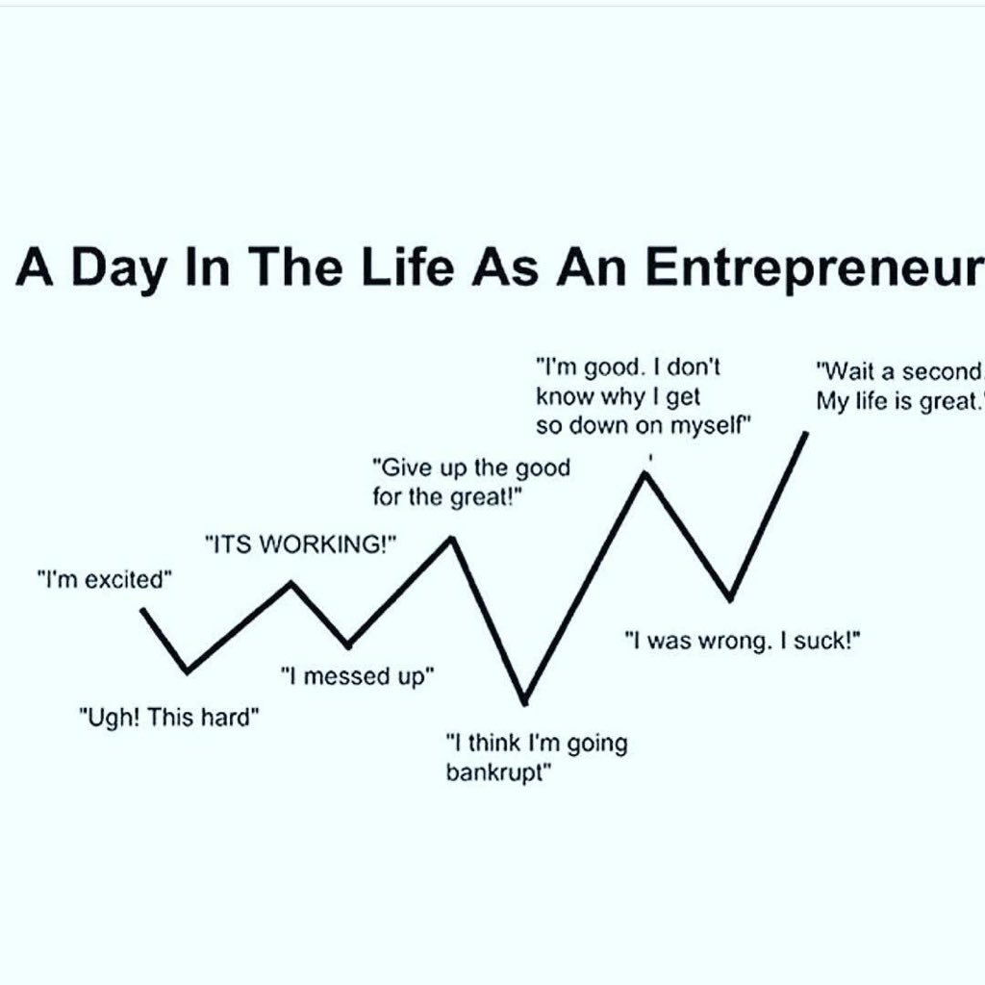

Slide 30

Pitfalls of Being an Entrepreneur
Constraints of lenders, laborers, customers, suppliers, and debtors curtail freedom of thought and work.
Frustration due to availability of limited capital and other resources.
Work-life balance under stress due to busy life and long hours of work.
Frustration due to non-achievement of full objectives.
Risk of failure and bankruptcy.

Slide 31
Impact of Entrepreneurship on Economy and Society
Impact of Entrepreneurship on Economy:
Improvement in living standards
Employment generation
Managing resources
Balanced regional development and economy growth
Import export promotion and capital formation
Technological advancement
Market place change
Contribution to large business
Provides international opportunities
Social and ethical awakening.

Slide 32
Impact of Entrepreneurship on Society:
1. Entrepreneurship creates employment: The existence of business activities influences employment. Business establishments need people to work for them.
2. Entrepreneurship improves the quality of life: People need to work in order to survive, attend to their needs, and satisfy their wants.
3. Entrepreneurship contributes to a more equitable distribution of income: With more entrepreneurial activities provided to the people in the country sides, natives have more work opportunities thus, discouraging them from resettling in other places.
4. Entrepreneurship utilizes resources: We may use our own natural resources, and process and convert them to more useful things.
5. Entrepreneurship brings social benefits through the government: The resources collected by the government are given back to the people in the form of services, infrastructure projects, school buildings, and maintenance of peace and order.

Slide 33

OPPORTUNITIES FOR ENTREPRENEURS IN INDIA & ABROAD
Tourism
Food Processing
Automobile
Corporate demands
Textiles
Ayurveda and traditional medicine
Social ventures
Organic farming
Software
Media
Engineering goods
Floriculture
Franchising
Healthcare sector
Education and Training
Biotechnology
Gems and Jeweler
Recycling business

Slide 34


